Slide 1
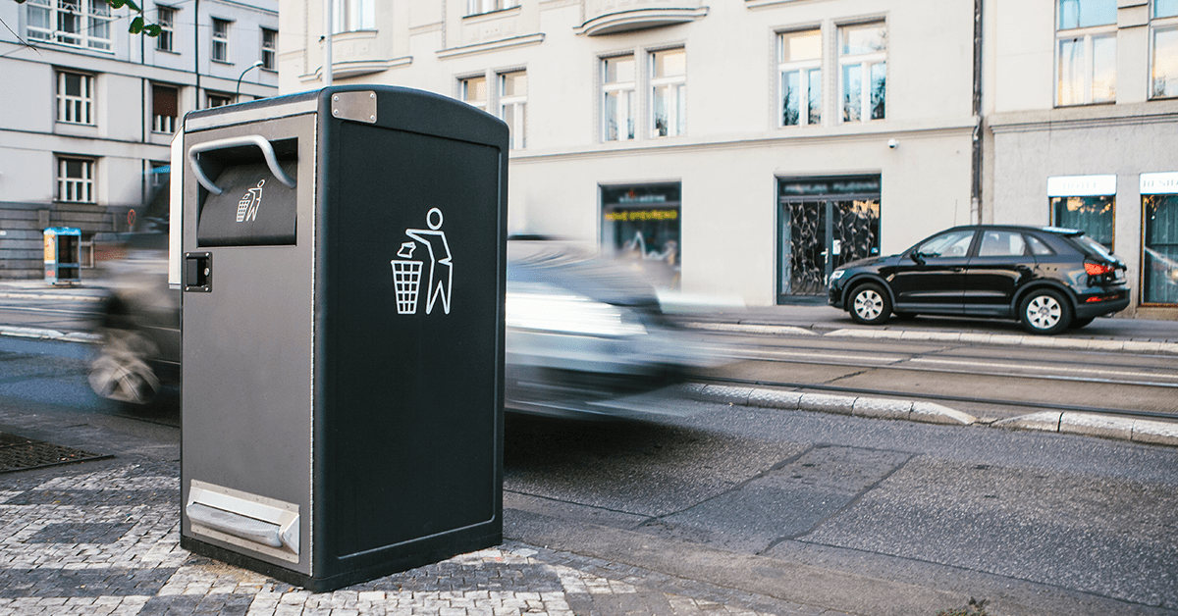
Stock-loss Prevention
- AI -
Team E
Borislav Pavlov, Young Oh Kim, Geo Ryang Park, Min Jae Kim
Capstone Design_SWE3028-41

Slide 2
Outline
Done:
we have improve the performance of our CNN model,
applying resnet-34 with a little bit modifying.
What to do in the future:
There are two options.
Add the LSTM as originally planned and apply it to the app.
2.We don't have much time left until the end of the semester, so we focus on applying this model to our apps.

Slide 3
Residual connection - Summary
64 filters
64 filters
128 filters
7
x
7
3
x
3
3
x
3
3
x
3
3
x
3
3
x
3
...
Input
Conv
Batch
Norm
Max
Pool
512 filters
1
x
1
256 filters
3
x
3
3
x
3
...
Conv
G.Avg
Pool
FC
layer for heatmap

Slide 4
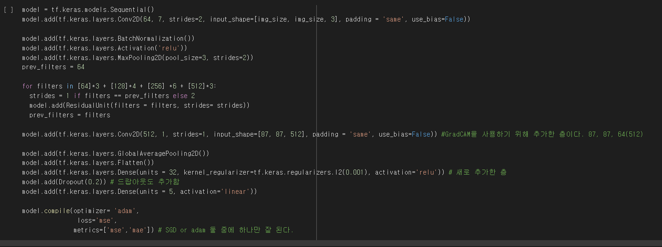
A little bit modified things
We extracted the heatmap image by adding an additional convolutional layer before flattening it.
and added l2 regulation and dropout to prevent overfitting.

Slide 5
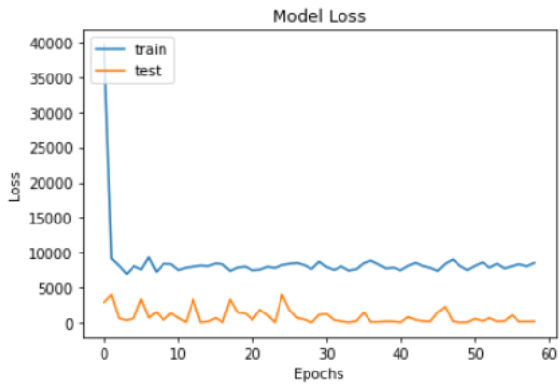
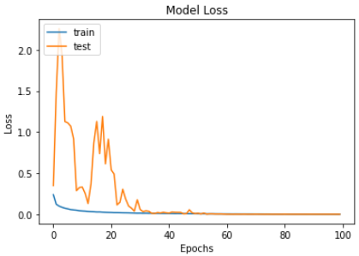
Improvement on loss values
(early stopping by overfitting)
After model improved
with residual
Epoch 52/500
- loss: 5818.9131
- mse: 5818.9131
- mae: 61.2323
- val_loss: 82.4641
- val_mse: 82.4641
- val_mae: 8.8668
Epoch 100/100
- loss: 6.3388e-04
- mse: 6.0789e-04
- mae: 0.0196
- val_loss: 3.9133e-05
- val_mse: 1.3282e-05
- val_mae: 0.0036

Slide 6
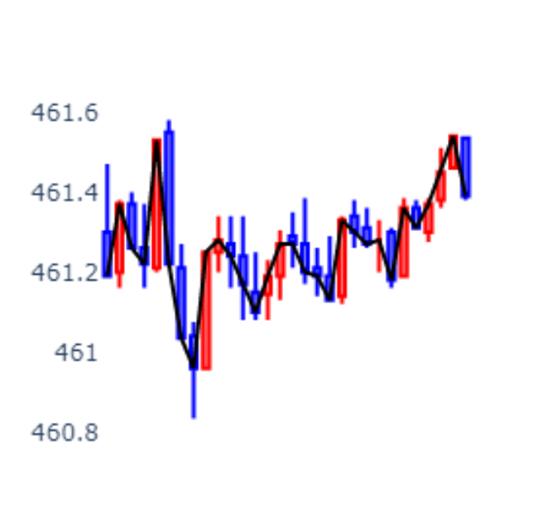
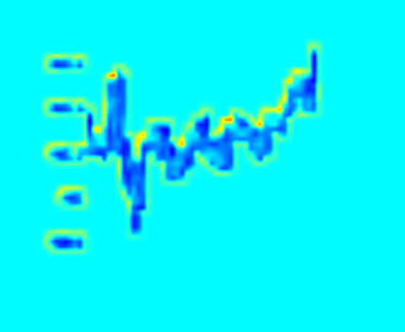

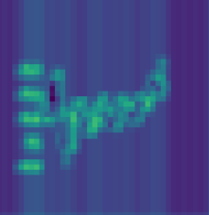
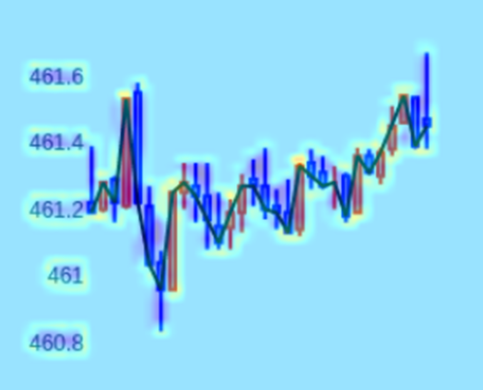
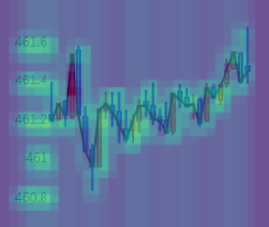
Heatmap images
Input Image
Heatmap
Heatmap
After model improved
with residual

Slide 7
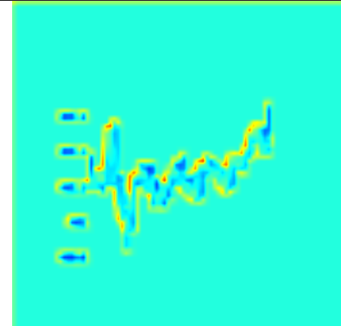
Trade-off
The better the model's performance, the worse the heatmap image.
epoch 20 case
If epoch is more than 200, the image is only a blue screen.

Slide 8
2 options
Add the LSTM as originally planned and apply it to the app.
2. We don't have much time left until the end of the semester, so we focus on applying this model to our apps.
we are troubled I will discuss it with other team members and make a decision.

Slide 9
References
[1] 핸즈온 머신러닝 2판, 오렐리앙 제롱 저, 박해선 옮김, 한빛미디어, resnet-34

